Slide 1
Development of Parylene C Microstructures for Biological Applications
Abhishek Dharan, ASU
2011-2012 NASA Space Grant Intern
Center for Biosignatures Discovery Automation at The Biodesign Institute at Arizona State University

Slide 2
Driving Force
Healthcare
Biological Research
Yesterday
  Treating Masses
  One approach fits all
  Large Scale = Economical
Tomorrow
  Individual Care
  Personalized Medicine
    Fit to specific genome
  Individualized Care=Efficiency
Yesterday
  Large Cultures of cells
  Averages
  Fit to biological system models
Tomorrow
  Single Cell Analysis
  Individual Outlier Data
  Fits nuances of biological system models

Slide 3
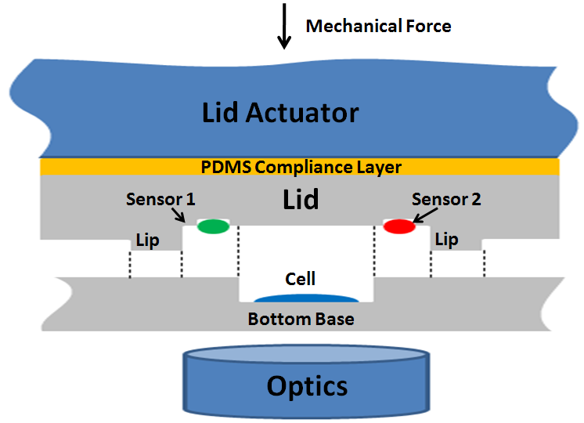
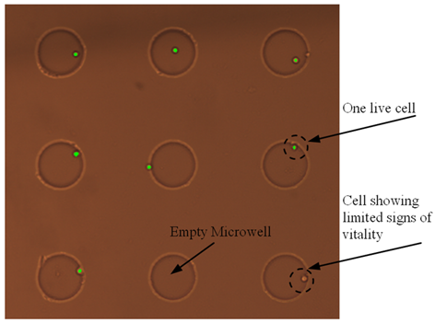
Microwell Design
Side view of microwell
Microwell in Action

Slide 4
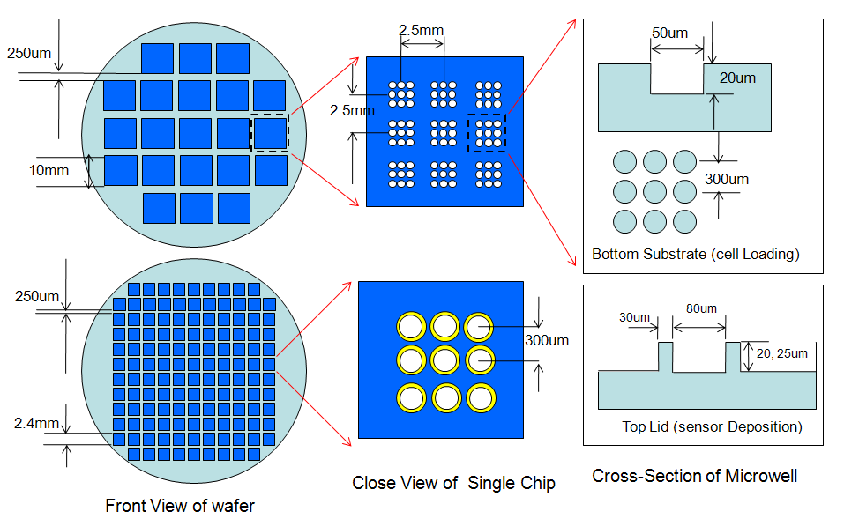
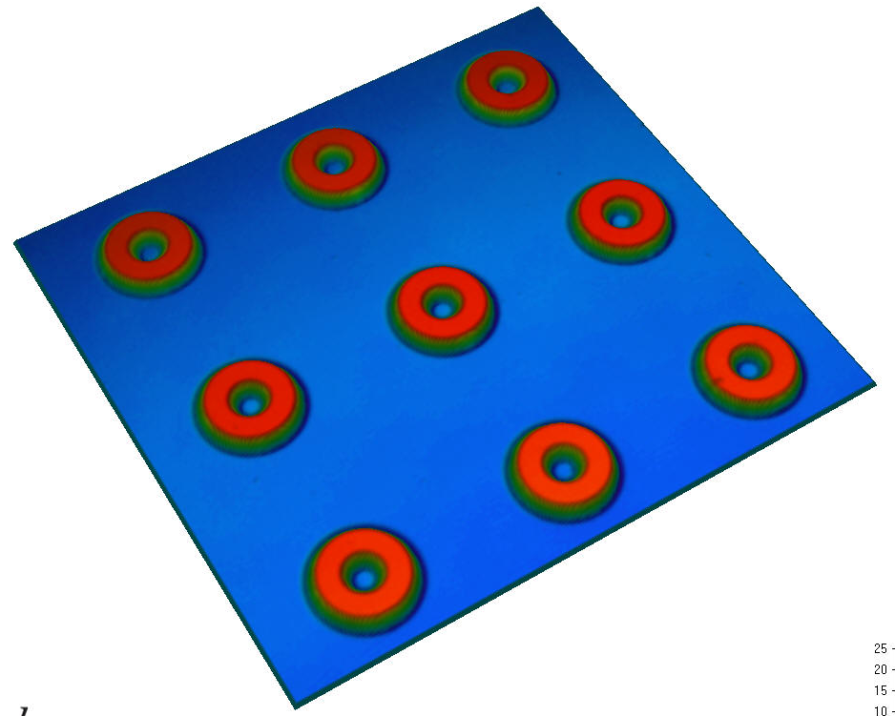
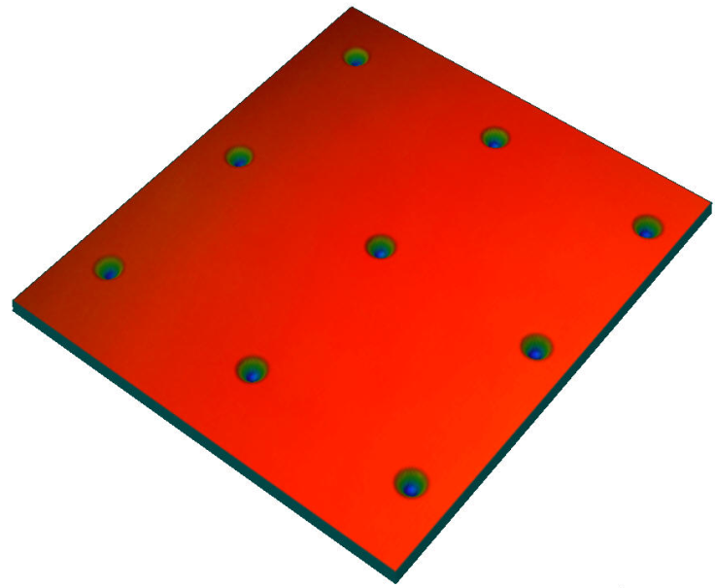
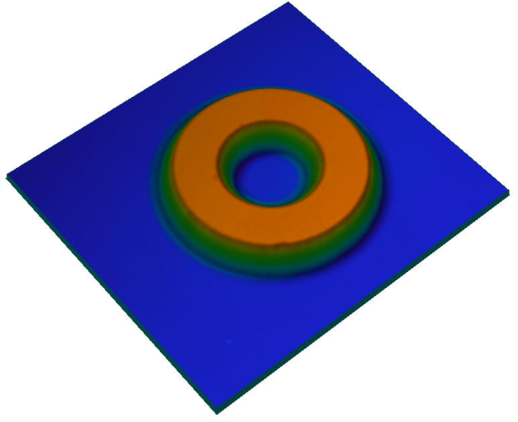
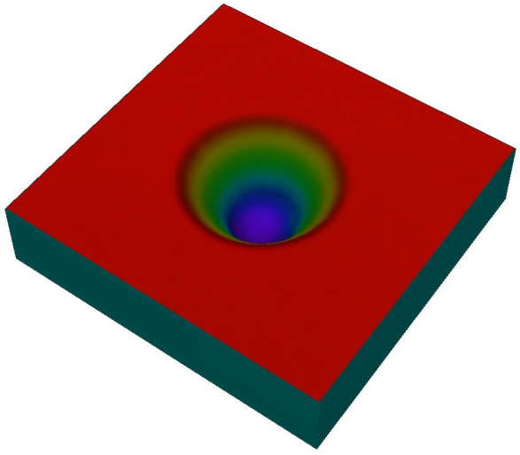
Overview
Microwell Systems

Slide 5
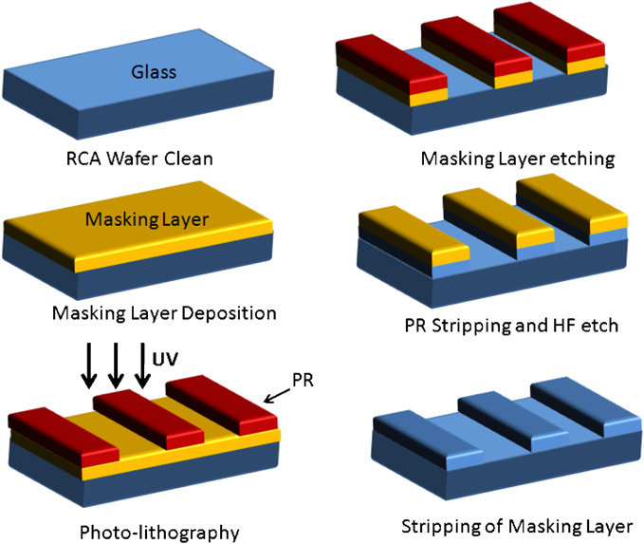
Fabrication Process

Slide 6
The Question?
Sealing
  No ion penetration through the wall
Downward Force
Array Density
Processing Time

Slide 7
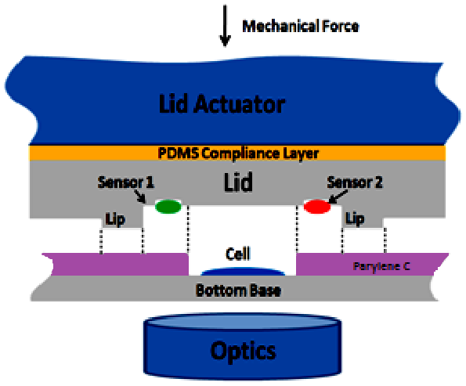
Proposed Design
pH sensor
O2 sensor

Slide 8
Why Parylene C?
Biocompatible
Vapor Deposited at room temperature
Highly Conformal
Compressible
Minimizes Gas Diffusion Rate
Optically Transparent

Slide 9
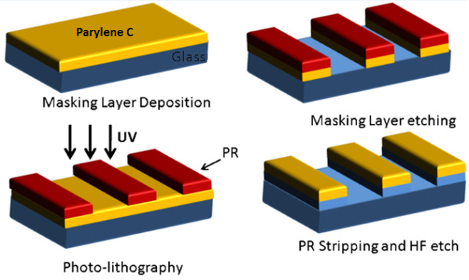
Additional Processing

Slide 10
Experimental Approach
Paper Study
Thin Film Parylene C
Adhesion
Device
Etching
Masking Layer

Slide 11
Results and Discussion
Parylene C coatings are uniform
Parylene C adhered well to the FS substrate (silanization utilized)
Parylene C resilient to solvents
Dicing possible with Parylene C
AZ 4620 and Cr identified as candidates for PR masking layer testing
More work needed in order to characterize Parylene C etching.

Slide 12
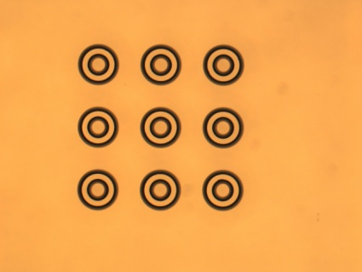
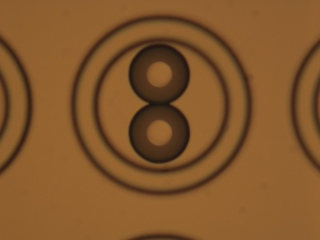
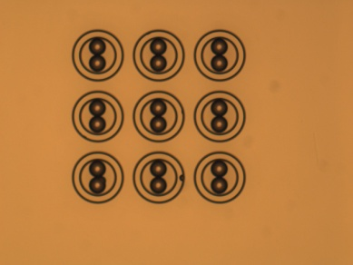
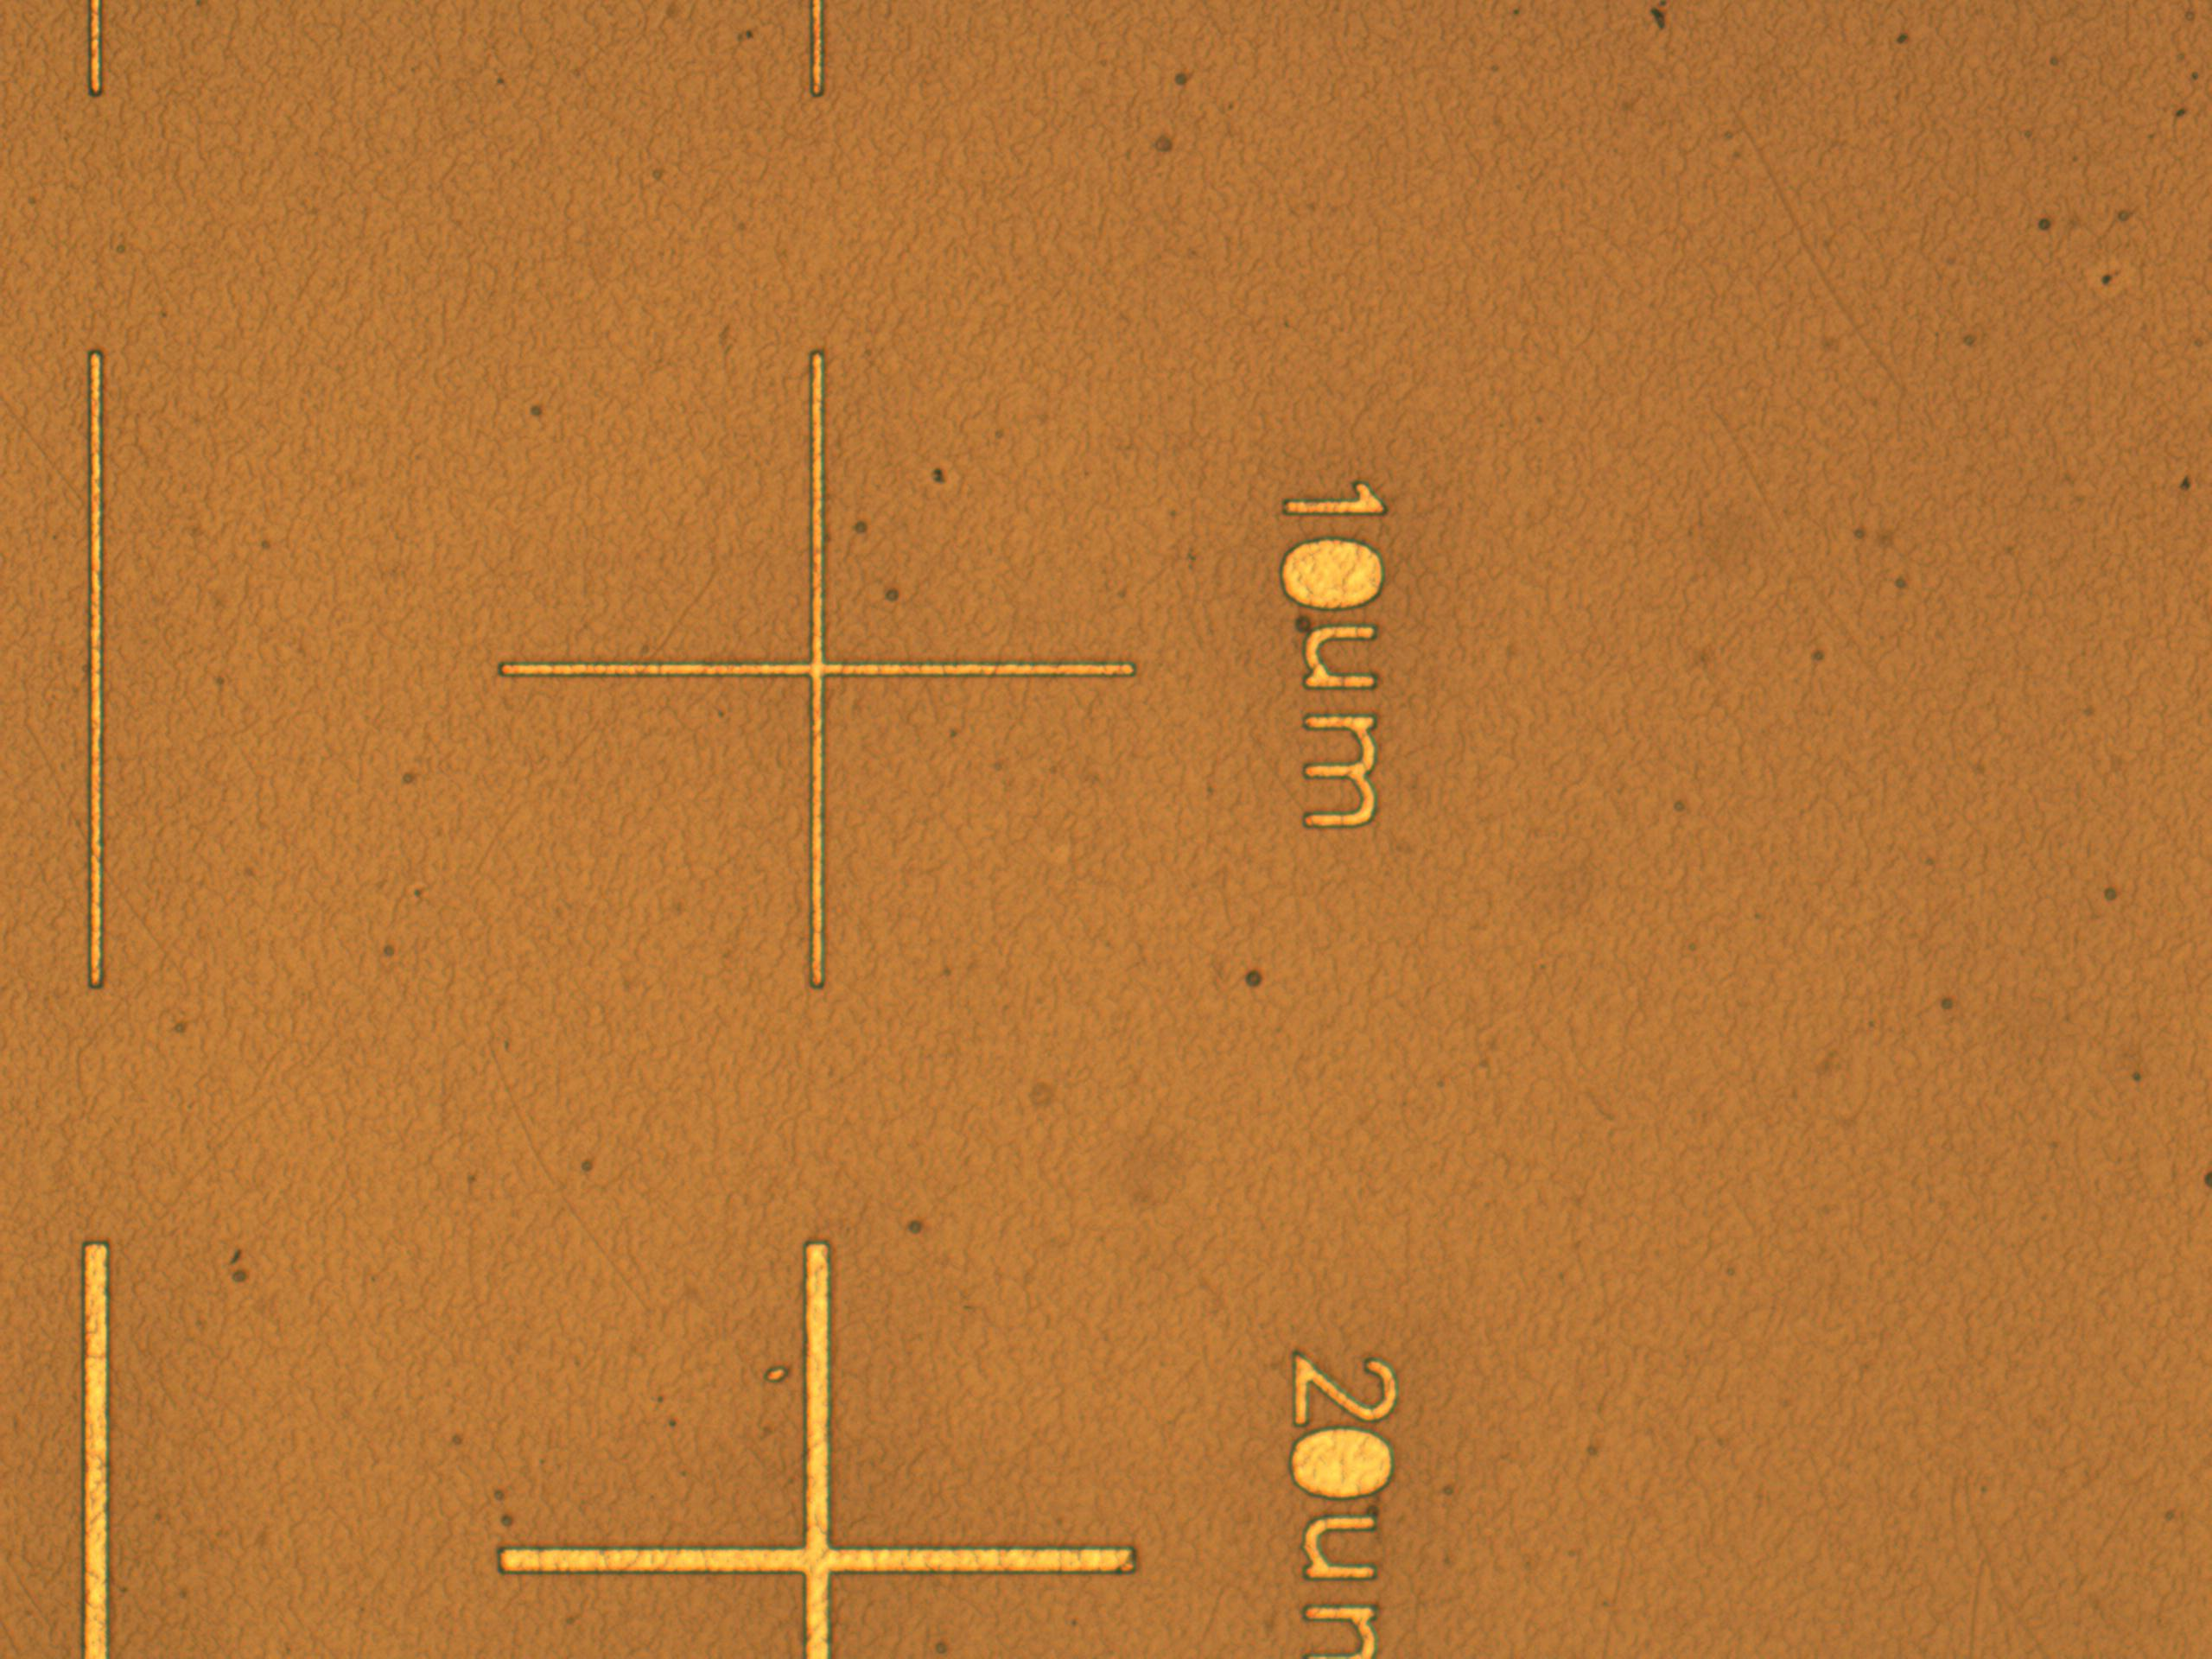
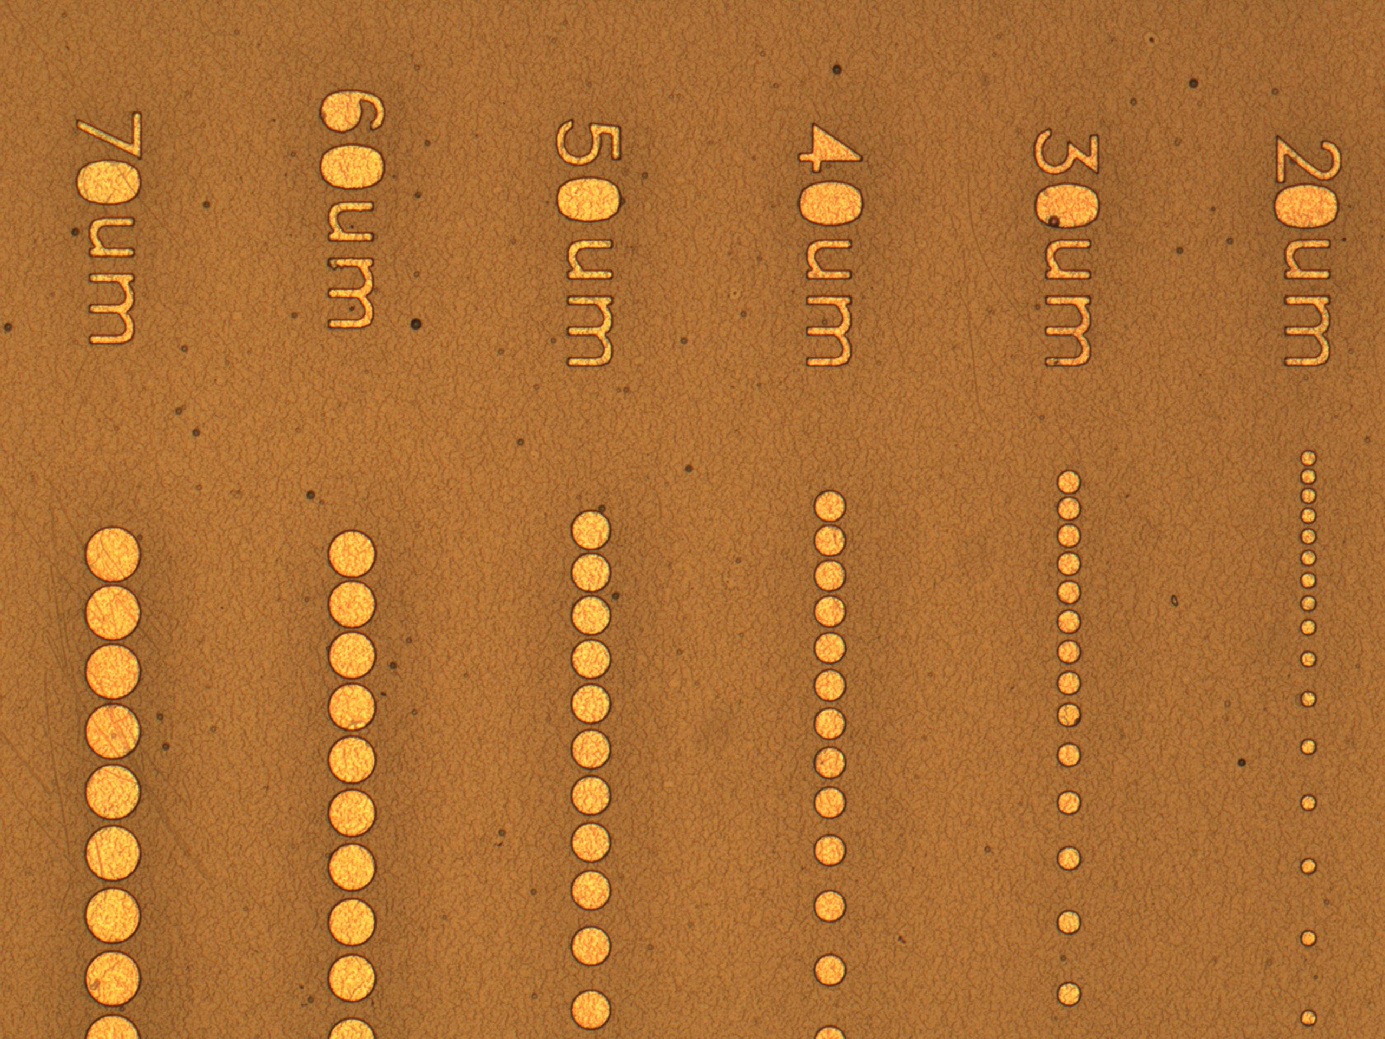
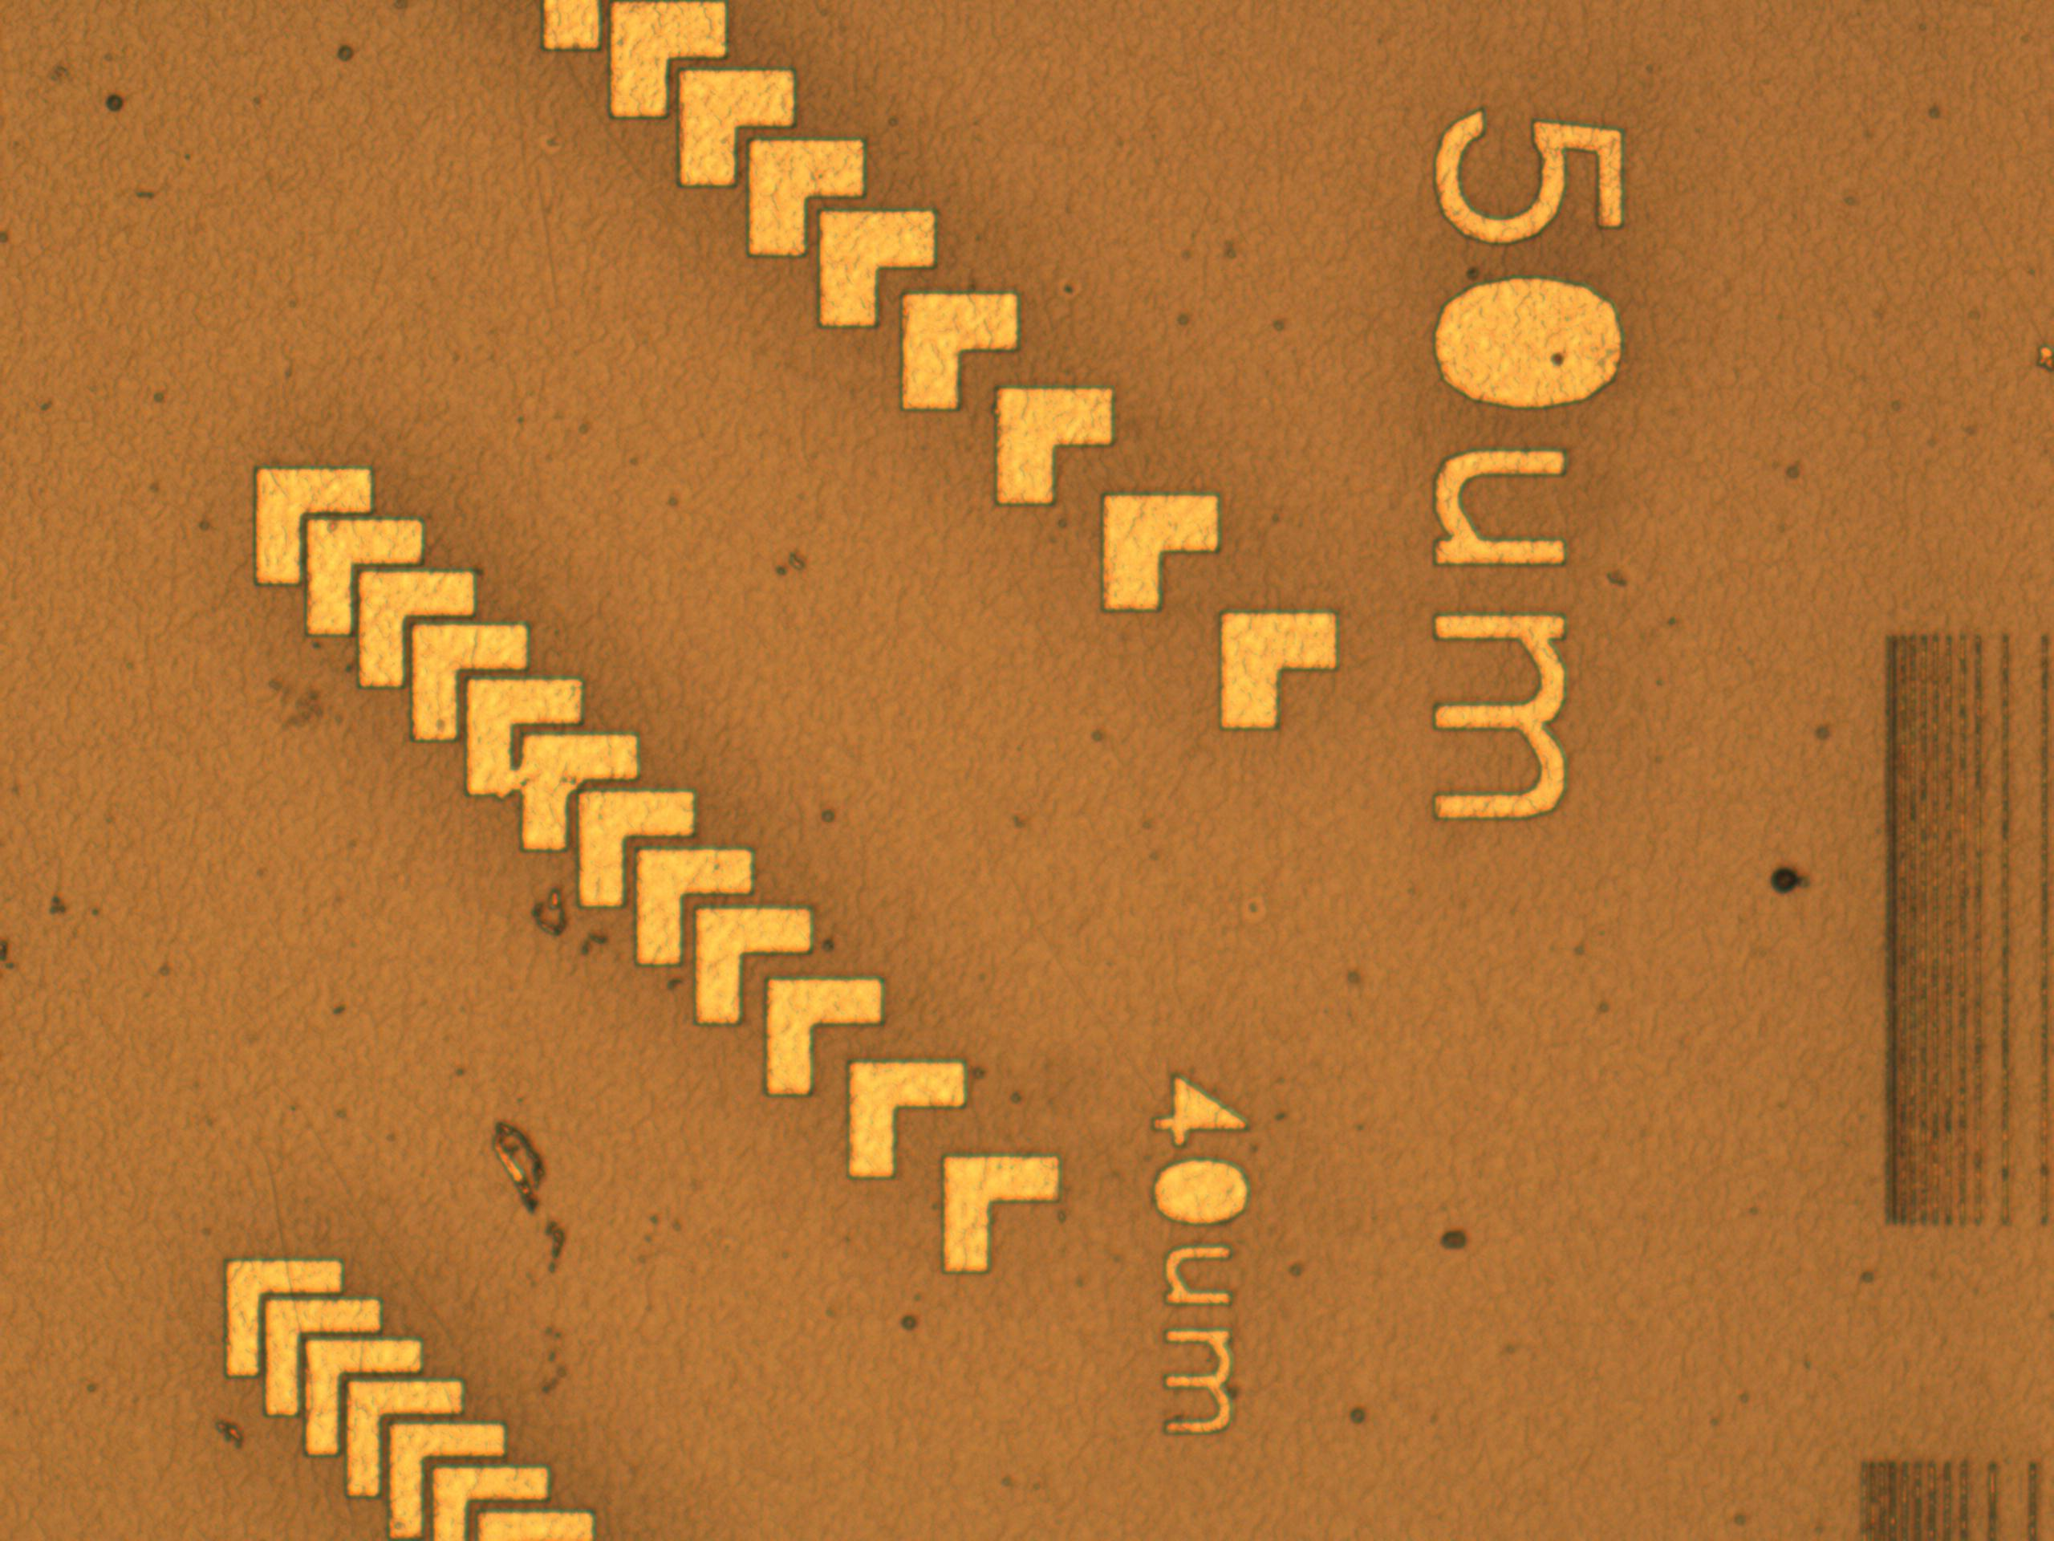
Results and Discussion
3x3 WOT Lids
3x3 double pocket WOT lids
Soda lime wafer after Chromium developing

Slide 13
Summary and Conclusions
Single Cell Metabolic Rate Monitoring System
Understand Cellular Heterogeneity
Thousands of microwell arrays
  Sub-micrometer geometry variation
Parylene C microwell Design
  Improves on existing microwell array design
  Potential to greatly enhance single-cell studies
  So far promising…but more work needed

Slide 14
Acknowledgements
Center for Biosignatures Discovery Automation
External
Dr. Haixin Zhu
Yasar Arafath Liaqath Ahmed Papa
Dr. Roger Johnson
Dr. Deirdre Meldrum
Lisa Alexander
Jakrey Meyers
Tathagata Ray
Iniyan Soundappa Elango
Adnan Mahmud
Dr. Laimonas Kelbauskas
Dr. Shashanka Ashili
Dr. Jeff Houkal
Center for Solid State Electronics Research
  Todd Eller
  Carrie Sinclaire
  John
  Paul
ASU NASA Space Grant
  Dr. Thomas Sharp
  Candace Jackson
  Stephanie

Slide 15
Comments or Questions?
Name: Abhishek Dharan, ASU
Email: adharan@asu.edu
Website: http://www.biodesign.asu.edu/research/research-centers/biosignatures-discovery-automation

